Slide 1
UI Validation
May 2021

Slide 2
Form validation today: The challenge
Motivations for validation
Doc links
Proposal for simple validation support

Slide 3
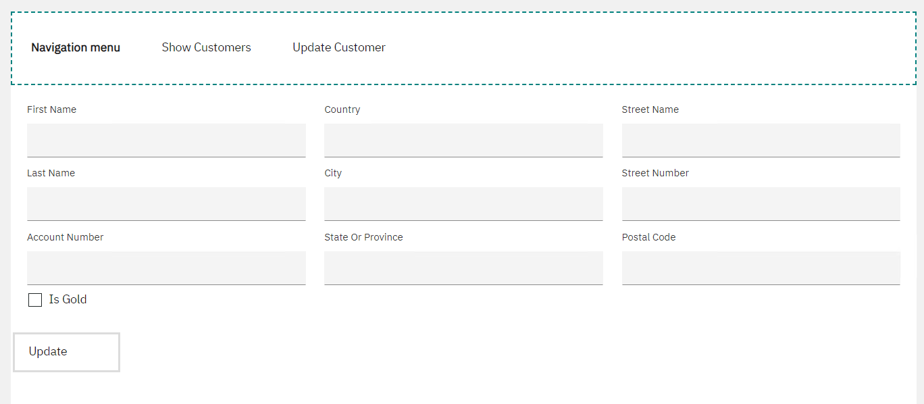
There are different flavours of validation for client UIs
Server-side logic
With this approach, logic on the server is called after a coach/page is complete (the user presses a button)
Example: customer update form and we want to validate the country is supported

Slide 4
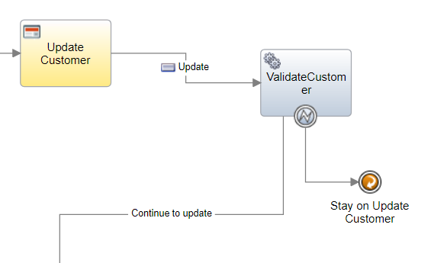
Server-side logic cont…
In the diagram, we call an Action
The Action throws an error if validation fails
We catch the error and stay on the page

Slide 5
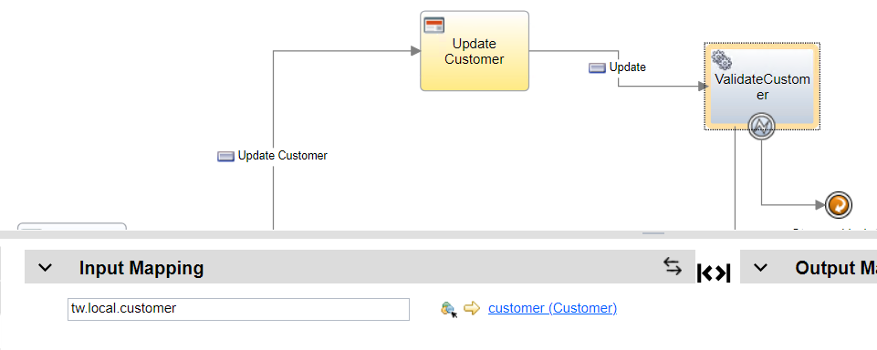
Server-side logic cont…
The data is passed into the validation Action

Slide 6
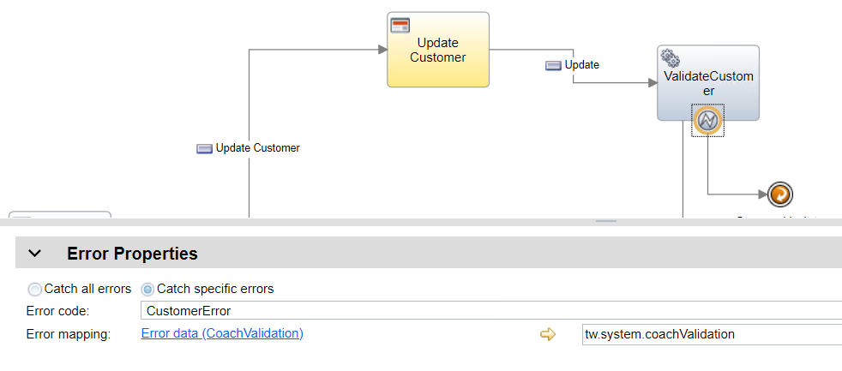
Server-side logic cont…
The data error boundary event catches specific errors and assigns the error data to the special tw.system.coachValidation property

Slide 7
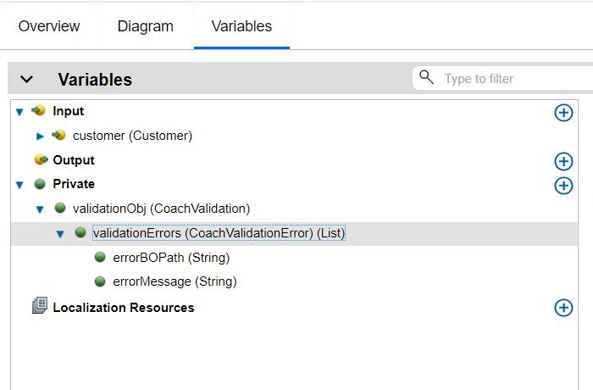
Server-side logic cont…
The Action takes in the customer and has a private variable of a special type: CoachValidation

Slide 8
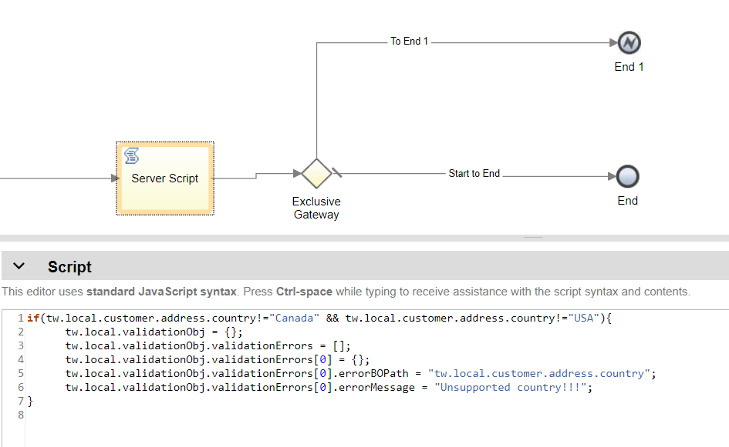
Server-side logic cont…
The Action script performs the validation in our sample, creating the proper CoachValidation data structure:
*** note that the errorBOPath has to match the variable in the App!!

Slide 9
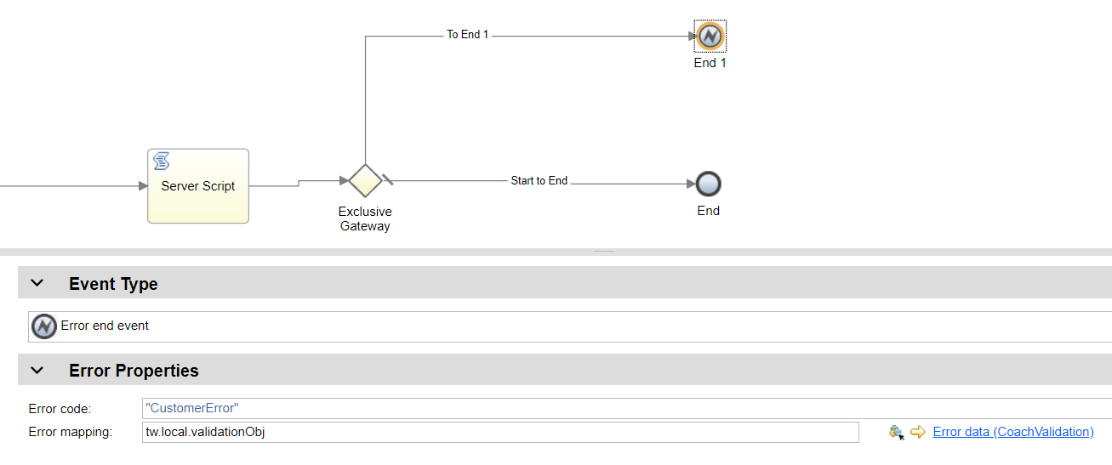
Server-side logic cont…
The error end node is traversed when there is validation data and it assigns the error data

Slide 10
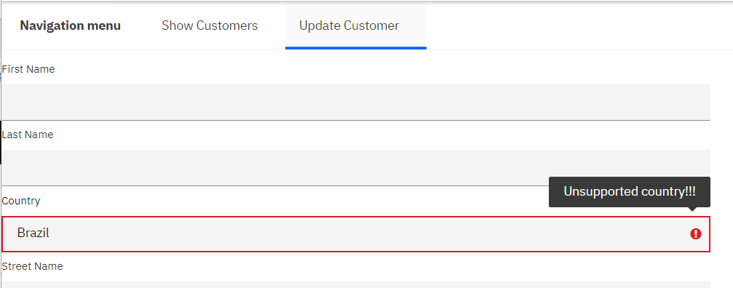
Server-side logic cont…
With all this in place, it works at runtime:

Slide 11
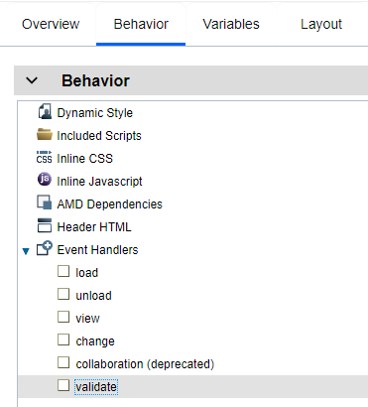
Server-side logic cont…
The errorBOPath is used by the coach runtime to fire the validation() event handler function of the view bound to that path
This is the same for client-side validation
It is dependent on the view implementing the function

Slide 12
Server-side logic cont…
Why server-side validation?
Validate against sensitive data that cannot be sent to client
Large amount of data needed to validate
Other services needed to validate

Slide 13
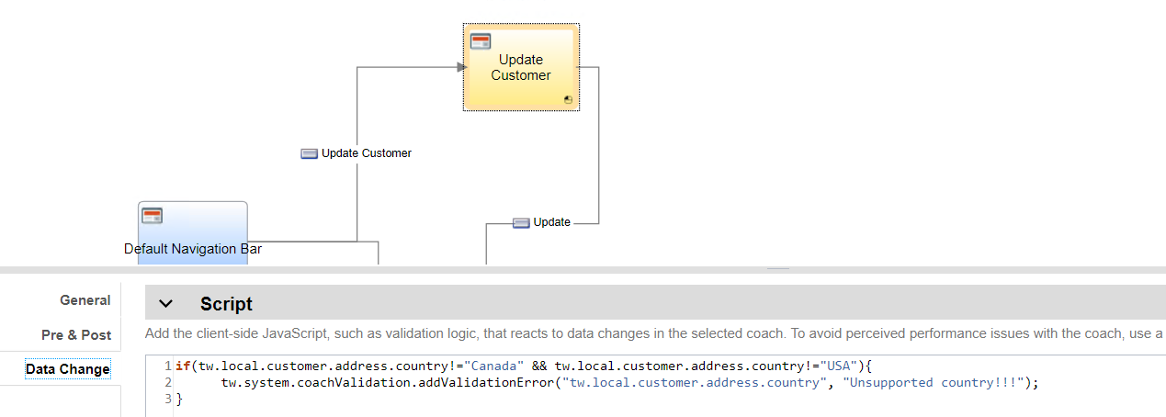
Client-side logic
If going back to the server is not needed, then client side validation may be more appropriate
In this method, you leverage the Data Change event on the coach. This gets called when any data changes in the coach

Slide 14
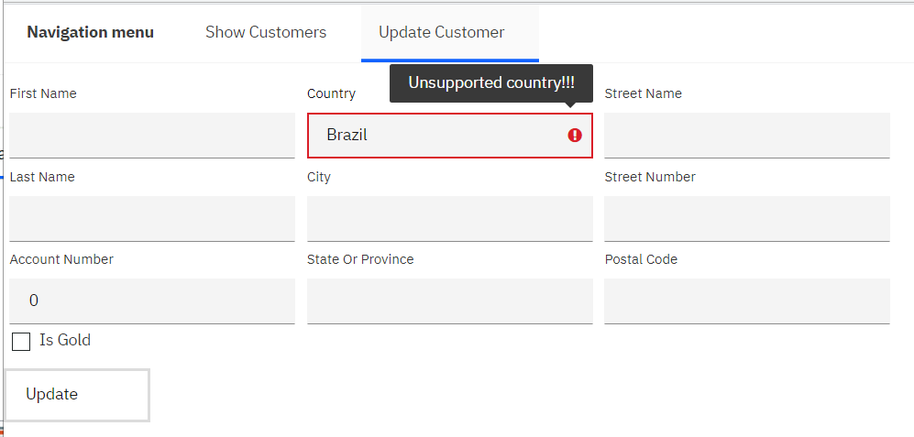
Client-side logic
The same visualization is seen at runtime

Slide 15
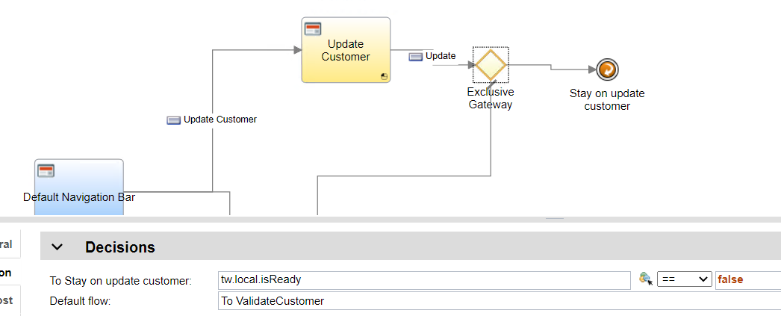
Client-side logic
But I can still complete the page!!
You could add a gateway to stay on page if validation errors exist:

Slide 16
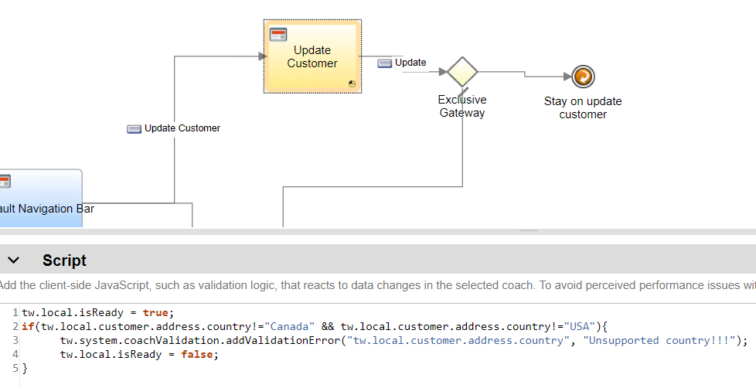
Client-side logic
Which uses new code in the data handler

Slide 17
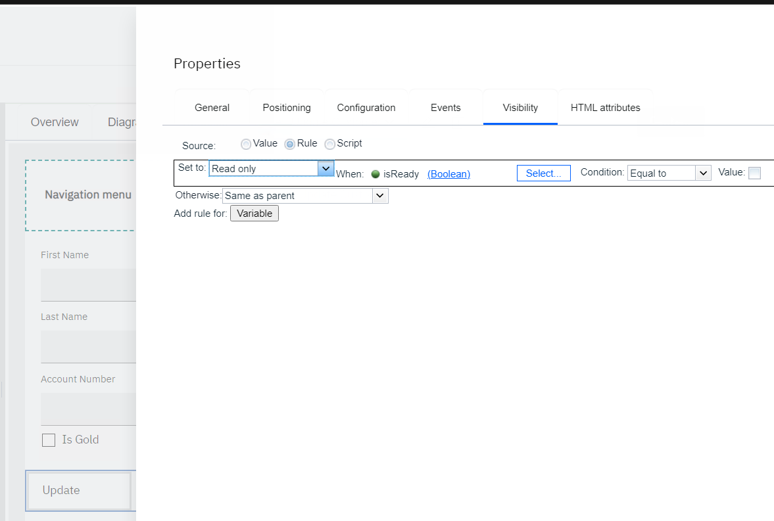
Client-side logic
Or you could disable the button until there are no validation errors
Uses the same new variable we added

Slide 18
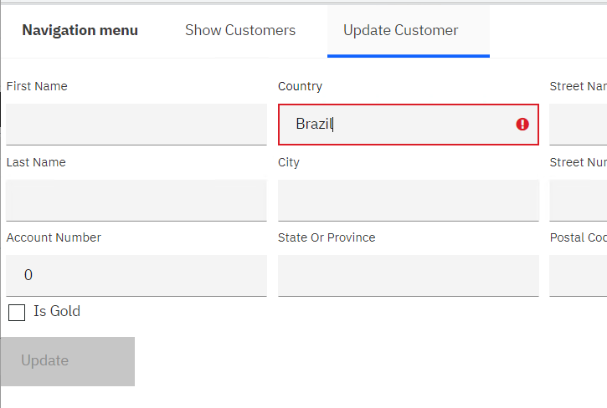
Client-side logic
Disabled button at runtime

Slide 19
Form validation today: The challenge
Motivations for validation
Doc links
Proposal for simple validation support

Slide 20
We’ve talked about how to implement validation but what do users actually want to validate?
Two common validation scenarios
Required fields
A class of validation wherein a field must be filled in for the form to be deemed complete
Potential sources of field required status:
Case has required flag
Open API has required flag
Calling automation services (what if the automation service is being called on page load… do we validation required inputs?)
User-driven as the user authors the UI

Slide 21
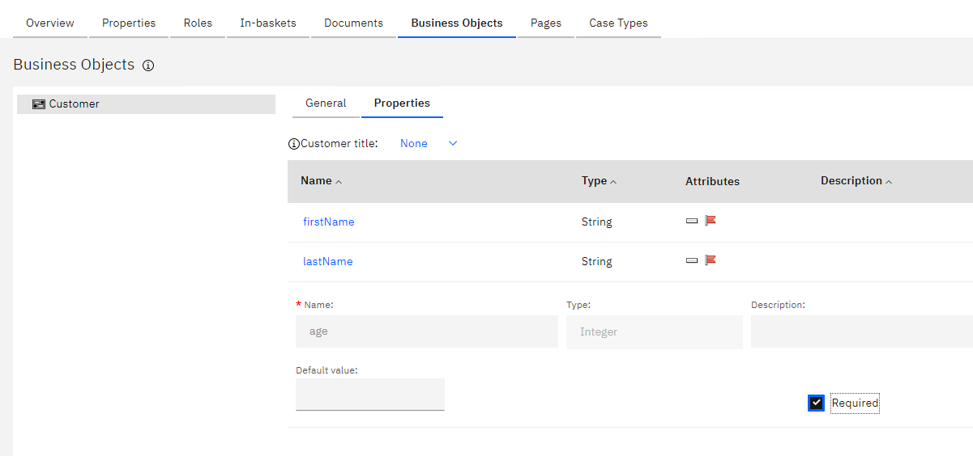
Case has the required flag when referencing properties:

Slide 22
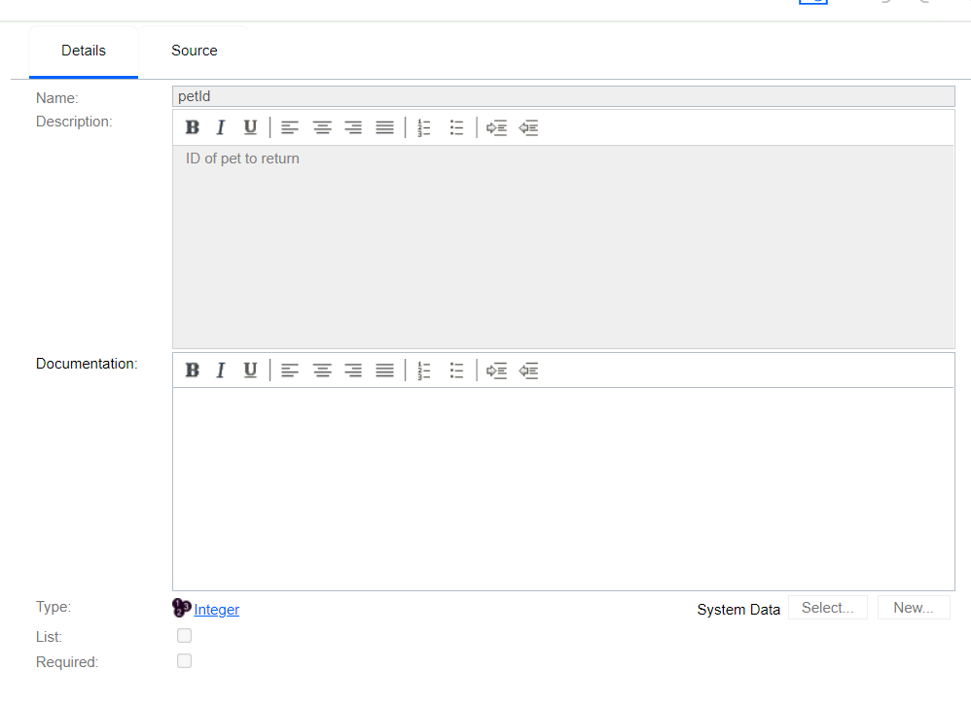
Open API has required flag

Slide 23
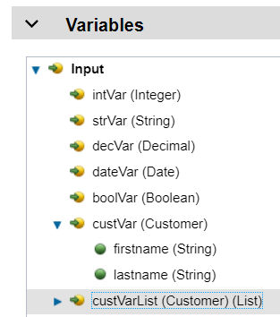
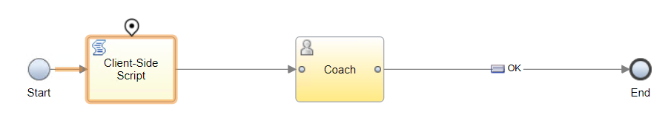
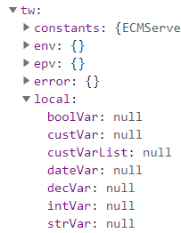
Required fields
What does it mean to have a value for a required field?
The UI framework automatically initializes data structures!!

Slide 24
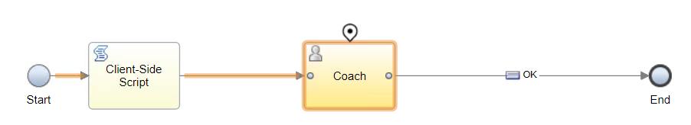
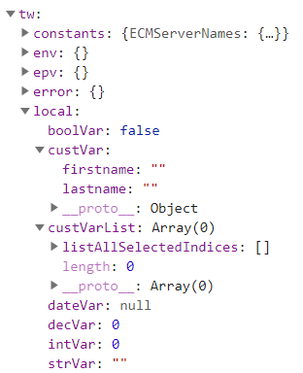
UI framework initializes vars:

Slide 25
Given the variable initialization, we surmise that “required” applies only to String primitives, meaning not empty string
What about Lists? Should they have at least one item?
Yes.

Slide 26
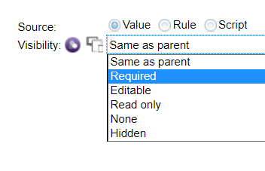
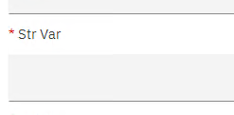
Note that we do have a required setting on view instances today, but it only results in an indicator on the glass

Slide 27
Data value restrictions
Validations ensure the values entered meet some criteria
Business object restrictions
Case data type restrictions
BOs generated from OpenAPI scenarios
User-authored BOs
User-driven as the user authors the UI?
Maybe not for the first version of this support? Maybe never?
Do we want to push for the data types to be declared with proper restrictions? I’d say yes, given the common data definition work.

Slide 28
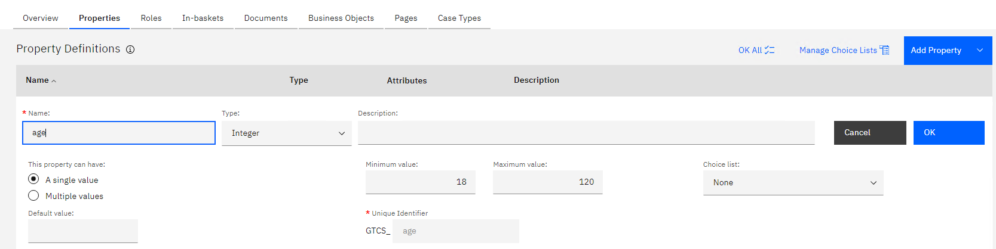
Case data type restrictions

Slide 29
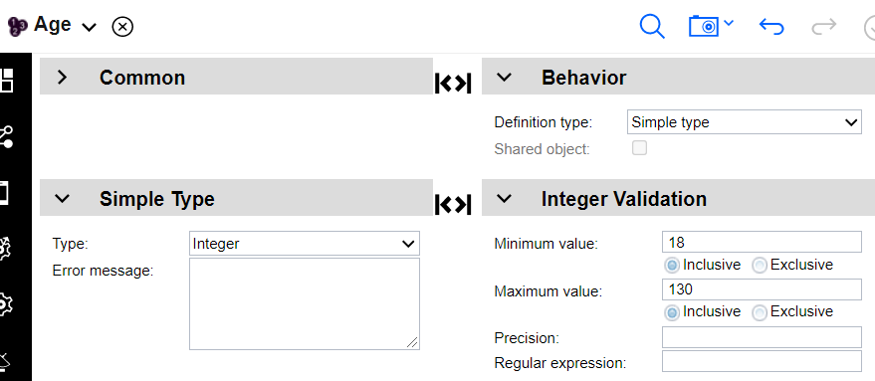
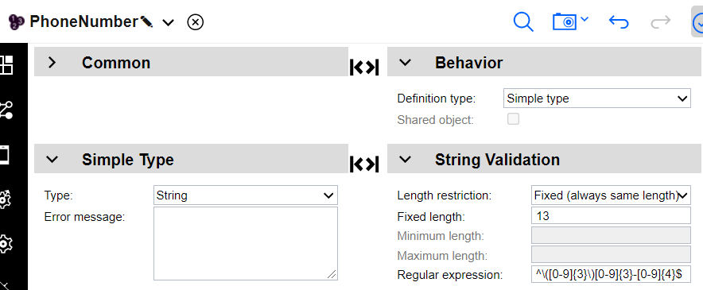
Business Object restrictions

Slide 30
No matter the source of the data restriction, it gets mirrored/generated into the BO model
We will introspect the restriction information in the BO model only
The assumption is that the BO model will be enhanced in the future to capture more cases. This will require runtime updates.

Slide 31
Form validation today: The challenge
Motivations for validation
Doc links
Proposal for simple validation support

Slide 32
The current support:
Requires code
Requires modifications of diagram with patterns that may not be obvious
Requires changing code in multiple places, potentially
The goal:
Simple, no-code validation
No extra artifacts needed
Set up validation from the layout (shouldn’t need to go to diagram, variables, advanced properties, etc)
Cannot conflict or interfere with existing techniques
Existing views should work with the built-in system
Leverage existing validation() lifecycle method

Slide 33
Line in the sand for built-in validation:
We will only support client-side validation
Validation cannot require other services

Slide 34
Features of built-in validation
Required field validation (strings, date, lists)
Simple data validation (range, regex, etc)
Can stay on page if validation errors exist
Must be based on specific buttons/boundary events
Scenario: Could have a “back” button and validation is not desired
Can disable views based on presence of validation errors

Slide 35
Intelligent configuration of views
Simple: decimal places? The views don’t support restricted range for integers, decimals, as an example.
Challenge: masked text would be great for Strings with regexs… but this would be difficult
Choice list with multiple values (unique vs overlapping allowed)

Slide 36
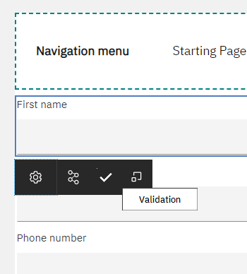
Validation is executed on data in the Application
Validation is executed on primitive/simple fields
Leaves of composite types may be validated
The user can access the validation page directly from views:

Slide 37
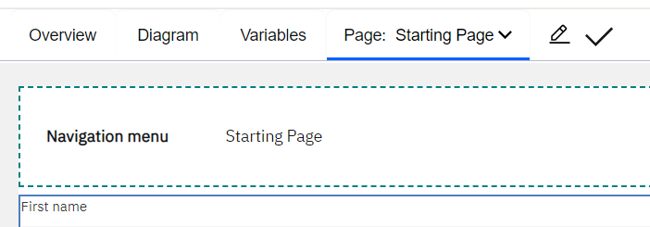
The user can access the validation slide out from the toolbar:

Slide 38
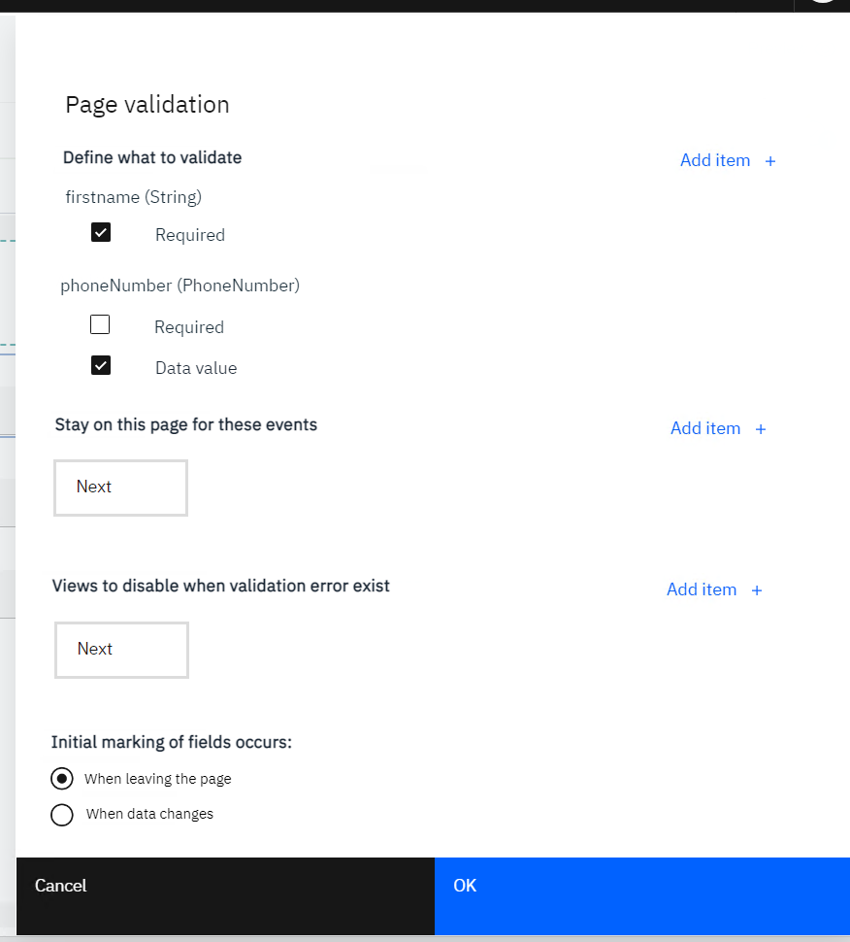
The validation settings for a page are managed on a slide out:

Slide 39
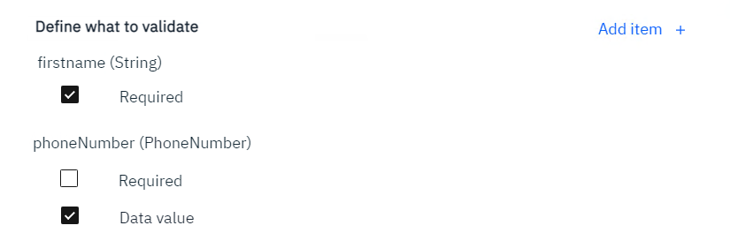
Breaking down the sections > Define what to validate
Contains a list of the data that will be validated

Slide 40
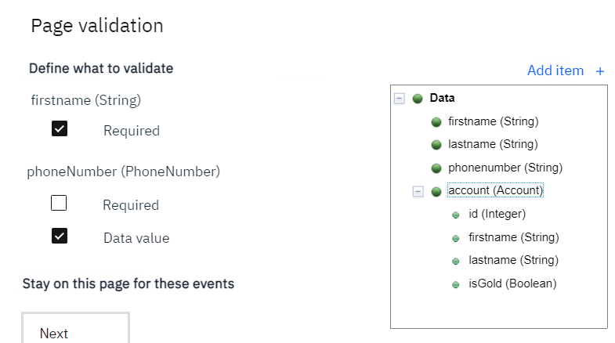
Breaking down the sections > Define what to validate
New data items can be selected by clicking on Add item
Only primitive/simple/List items can be selected

Slide 41
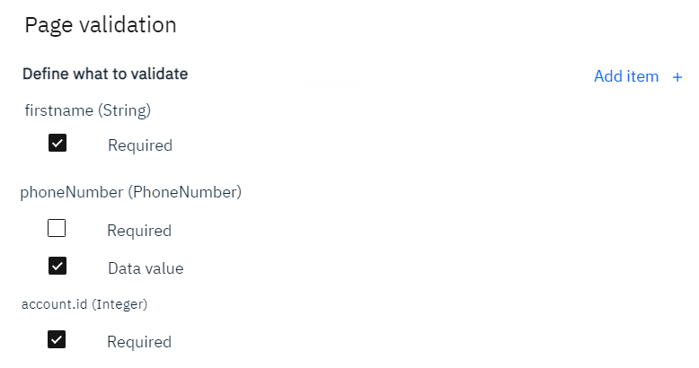
Breaking down the sections > Define what to validate
After selecting account.id (you can’t select this though!!)

Slide 42
Breaking down the sections > Define what to validate
An entry can be added directly from the layout
If data bound to the view isn’t added to the list, it will be added
If the bound data is a complex type, the chooser is shown

Slide 43
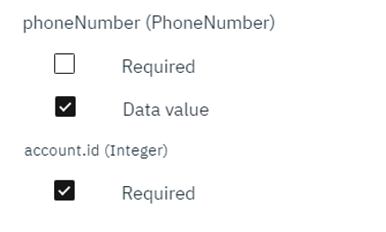
Breaking down the sections > Define what to validate
The Data value checkbox only appears of the type is a simple type (restriction)
For primitive types, we already have controls that ensure values entered are proper (Integer control doesn’t allow random chars, for example)

Slide 44
Breaking down the sections > Define what to validate
The data paths to validate will be saved in the coach/page (com.ibm.bpmsdk.model.bpmn20.ibmext.TFormTask)

Slide 45
Breaking down the sections > Define what to validate
{
"outgoing": ["2027.80cc6079-ccb3-4ecb-84a1-b03101a87533"],
"incoming": ["2027.5438df80-bfbe-4697-8eae-3a7a7de01a74", "2027.768c8d8d-08d3-4c2e-a0f4-a388c6c09925"],
"extensionElements": {
"nodeVisualInfo": [{
"width": 95,
"x": 350,
"y": 177,
"declaredType": "TNodeVisualInfo",
"height": 70
}],
"preAssignmentScript": ["tw.local."] ,
“validationDataPaths": [{“path“:”tw.local.age”, “required”:false, “valueValidation”:true}]
},
"declaredType": "com.ibm.bpmsdk.model.bpmn20.ibmext.TFormTask",
"isHeritageCoach": false,
"cachePage": true,
"startQuantity": 1,
"formDefinition": {
"coachDefinition": {
"layout": {
...
},
"declaredType": "com.ibm.bpmsdk.model.coach.TCoachDefinition"
}
},
"commonLayoutArea": 0,
"name": "Starting Page",
"isForCompensation": false,
"completionQuantity": 1,
"id": "2025.45b1c927-3505-434b-8610-bccb9ab8cc1a"
}
When do we use extensionElements vs regular property (like cachePage)?

Slide 46
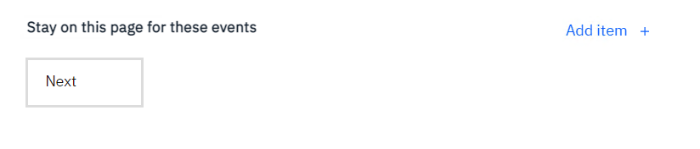
Breaking down the sections > Stay on this page for these events
This is defining which boundary events will result in the validation logic running and preventing the user from leaving the page

Slide 47
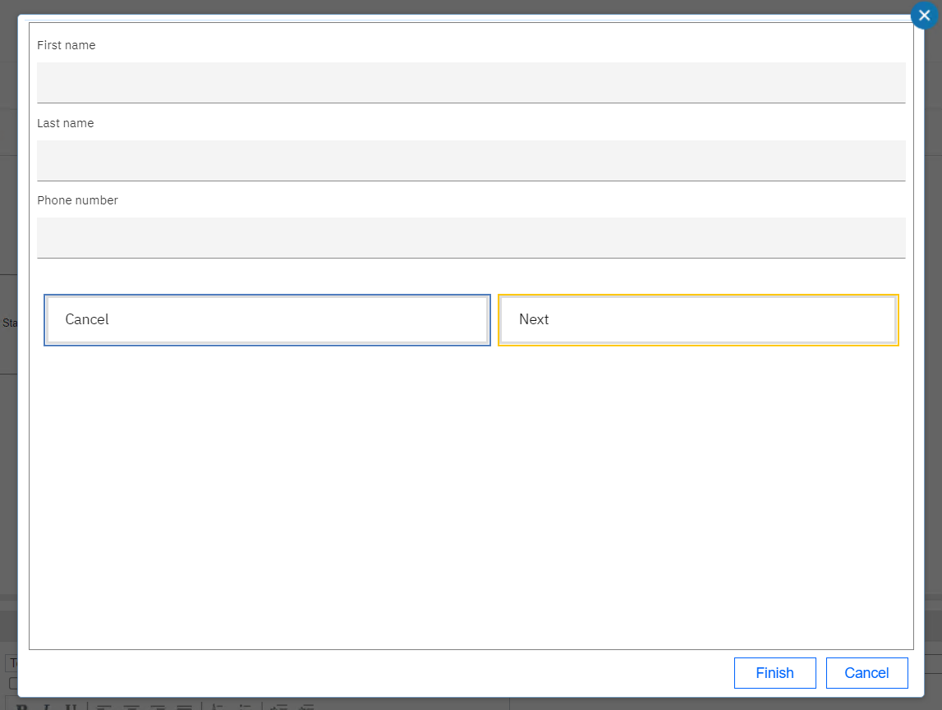
Breaking down the sections > Stay on this page for these events
Clicking Add Item would bring up the same picker as the diagram

Slide 48
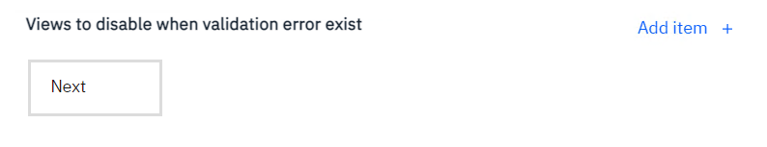
Breaking down the sections > Views to disable when validation errors exists
This setting allows, for example, a button to be disabled until the page is valid
Note that the validation would need to be run all the time (not just on a boundary event) in order for this behaviour to work properly

Slide 49
Breaking down the sections > Views to disable when validation errors exists
Clicking Add Item would bring up the same picker as the diagram except all views are selectable (not just those that fire boundary events)

Slide 50
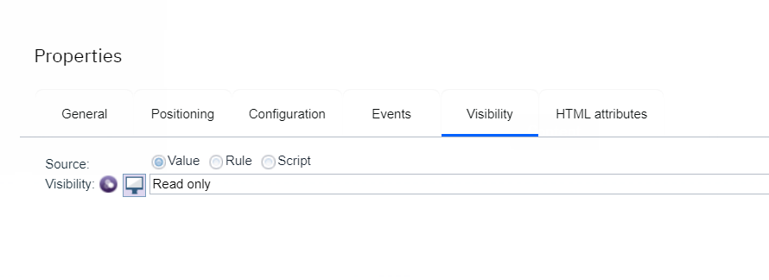
Breaking down the sections > Views to disable when validation errors exists
Under the covers, the UI runtime sets the visibility property of these views:
Idea: maybe visibility should include a new option: “based on validationErrors”
The runtime will have to keep track of the original visibility setting and return it to the proper state
What if some other code also programmatically changes the visibility?
This setting works based on validationErrors, so it would work with user Data Change scripts too

Slide 51
Breaking down the sections > Views to disable when validation errors exists
When setting data path to be required, do we allow/suggest visibility to be setup at the same time?

Slide 52
Breaking down the sections > Views to disable when validation errors exists
Both the “stay on page” and “disable” behaviours are captured as built-in configuration options on the view instance in the layout
{
"layoutItemId": "Button1",
"configData": [{
"valueType": "static",
"declaredType": "com.ibm.bpmsdk.model.coach.ConfigData",
"id": "67def2c7-f061-4ef7-8b3f-cc793e68a2ca",
"optionName": "@label",
"value": "Next"
}, {
"declaredType": "com.ibm.bpmsdk.model.coach.ConfigData",
"id": "a87abe90-b3bb-422c-8573-19dd5bcc663a",
"optionName": "@validationStayOnPage",
"value": "true"
}, {
"declaredType": "com.ibm.bpmsdk.model.coach.ConfigData",
"id": "a87abe90-b3bb-422c-8573-19dd5bcc663a",
"optionName": "@validationDisable",
"value": "true"
}],
"viewUUID": "64.7133c7d4-1a54-45c8-89cd-a8e8fa4a8e36",
"declaredType": "com.ibm.bpmsdk.model.coach.ViewRef",
"id": "42d9a89d-6d83-45b1-880f-678eec63f4d3",
"version": "8550"
}

Slide 53
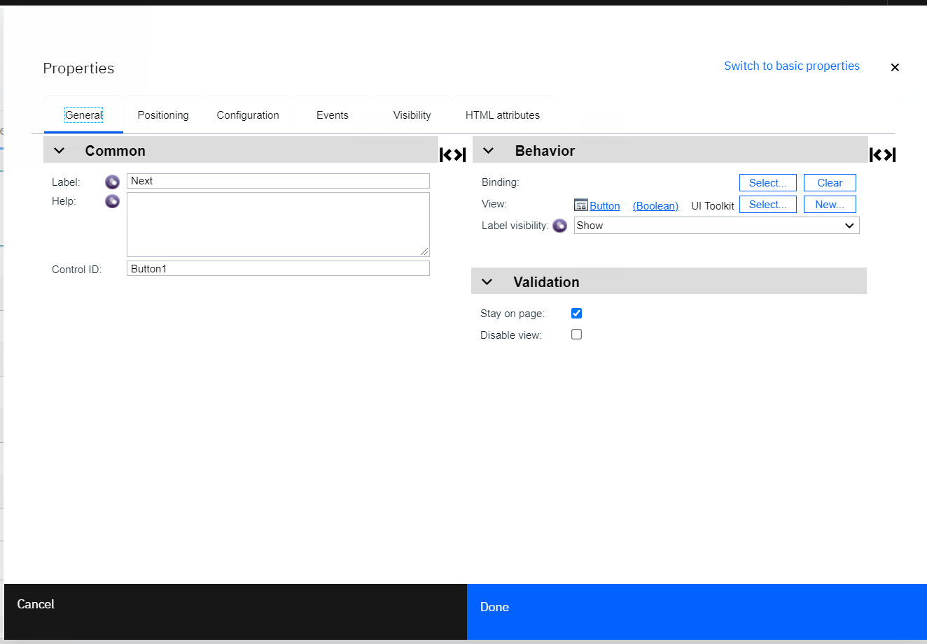
Breaking down the sections > Views to disable when validation errors exists
We could choose to have these options in the advanced properties of the layout item also

Slide 54
Breaking down the sections > Views to disable when validation errors exists
Both the “stay on page” and “disable” behaviours are captured on the Page
{
"outgoing": ["2027.80cc6079-ccb3-4ecb-84a1-b03101a87533"],
"incoming": ["2027.5438df80-bfbe-4697-8eae-3a7a7de01a74", "2027.768c8d8d-08d3-4c2e-a0f4-a388c6c09925"],
"extensionElements": {
"nodeVisualInfo": [{
"width": 95,
"x": 350,
"y": 177,
"declaredType": "TNodeVisualInfo",
"height": 70
}],
"preAssignmentScript": ["tw.local."] ,
“validationDataPaths": [{“path“:”tw.local.age”, “required”:true, “valueValidation”:false}],
“validationStayOnPagePaths": [“button1“, “compView1/button1”],
“validationDisablePaths": [“compView1/button1”],
},
"declaredType": "com.ibm.bpmsdk.model.bpmn20.ibmext.TFormTask",
"isHeritageCoach": false,
"cachePage": true,
"startQuantity": 1,
"formDefinition": {
"coachDefinition": {
"layout": {
...
},
"declaredType": "com.ibm.bpmsdk.model.coach.TCoachDefinition"
}
},
"commonLayoutArea": 0,
"name": "Starting Page",
"isForCompensation": false,
"completionQuantity": 1,
"id": "2025.45b1c927-3505-434b-8610-bccb9ab8cc1a"
}

Slide 55
Breaking down the sections > Views to disable when validation errors exists
How are these paths kept in sync?
Lazily clean up?
Show in the slideout in some way (unresolved view)
Runtime will need to gracefully handle stale refs, just like connections in the diagram
Idea: for disabled views, just set viz script to default script that disables if validation errors exist
When launch slide-out, look for this default script

Slide 56
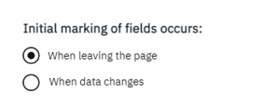
Breaking down the sections > Initial marking of fields occurs
When do fields show validation markers in the page?
In many cases, you want to give the user an opportunity to fill in the fields before decorating the UI with error markers
This setting provides such a two-phase validation approach
Should this apply to both required and data value validation? It makes sense to validate data values right away, no?
Another option: Validate if values change always, plus when leaving the page. We wouldn’t need this setting.

Slide 57
Flow of calls when Page/Coach is loaded:
Pre Script
Page is Loaded
Visibility Script/ Rules are run
Page Validation is Run
Visibility is set on views
Do we have any issues with async code running in views?
This should also be a problem with viz, if it is a problem at all.

Slide 58
Flow of calls after Page/Coach is loaded:
But both data change and page validation populate tw.system.validationErrors()
How can this work?
Perhaps the framework-managed entries can have a special flag so that the proper validation errors are cleaned up and ones created by the user’s data change script are left alone
Data Change
Handler
Visibility Script/ Rules are run
Page Validation is Run
Visibility is set on views

Slide 59
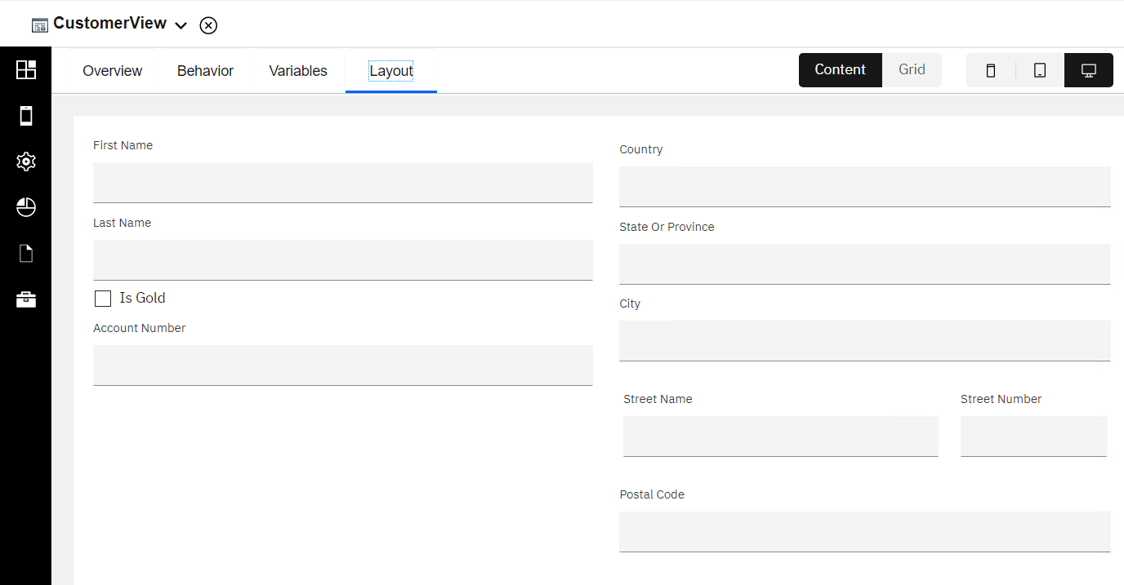
What about composite views?
I may have, for example, a Customer form:

Slide 60
I may want First name to be mandatory for every consumer of my View
However, the settings are made on a Page/Coach thus far
How can we achieve this?
We could have a similar setting on a view

Slide 61
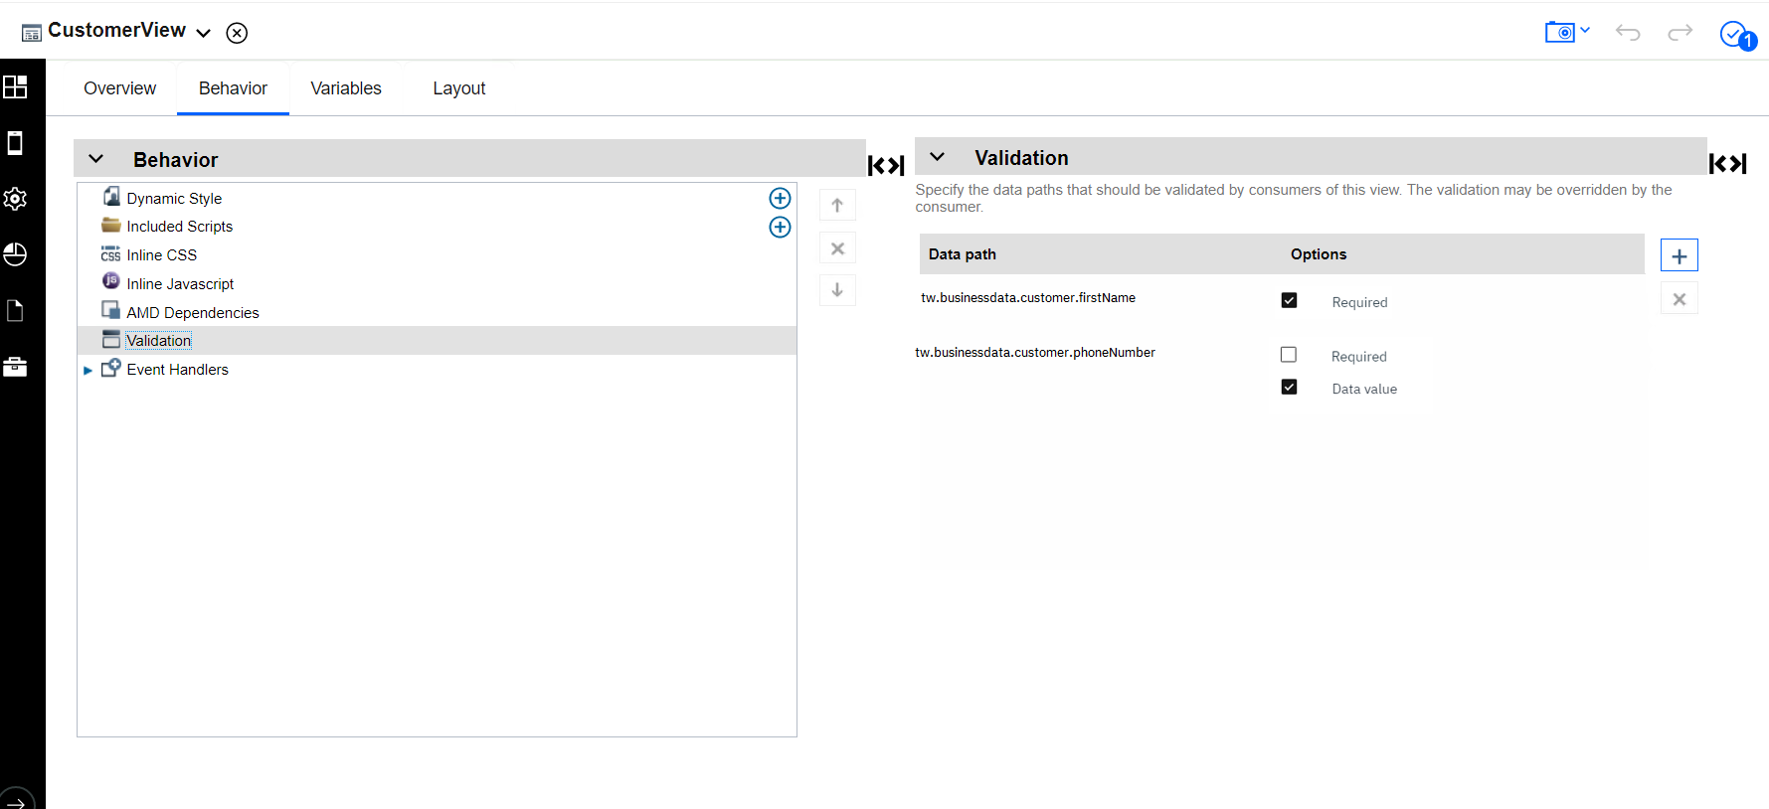
User can add paths to business data and config options

Slide 62
When the user consumes the view in the editor, we could apply the validation rules as defaults in the Page/Coach
Could be overridden
We could only set up these defaults when the data is bound to the view (otherwise we can’t figure out the data path in the page/coach)

Slide 63
What about common areas?
We don’t anticipate users putting validated fields in a common area
However, these might work without issue
Data paths are based on the variables for the App which span common areas
Selection of view paths should work without issue as well
The “stay on page” and “disabled” setting would need to be applied to each page that uses the common area, however.

Slide 64
Form validation today: The challenge
Motivations for validation
Doc links
Proposal for simple validation support

Slide 65
Doc links:
https://www.ibm.com/docs/en/baw/19.x?topic=coaches-after-exiting-coach
https://www.ibm.com/docs/en/bpms/8.5.6?topic=SSFTDH_8.5.6/com.ibm.wbpm.wle.editor.doc/topics/tcf_validatecoaches.html
https://www.ibm.com/docs/en/baw/19.x?topic=coaches-without-exiting-coach
https://www.ibm.com/docs/en/baw/19.x?topic=cve-example-validating-coach-in-client-side-human-service

